Slide 1
Multi-Rail LNet for Lustre
Olaf Weber
Senior Software Engineer
SGI Storage Software
Amir Shehata
Lustre Network Engineer
Intel High Performance Data Division
Intel and the Intel logo are trademarks or registered trademarks of Intel Corporation or its subsidiaries in the United States and other countries. *Other names and brands
may be claimed as the property of others. All products, dates, and figures are preliminary and are subject to change without any notice. Copyright © 2016, Intel Corporation.

Slide 2
Multi-Rail LNet: What and Why

Slide 3
Multi-Rail LNet
Multi-Rail is a long-standing wish list item known under a variety of names:
  Multi-Rail
  Interface Bonding
  Channel Bonding
The various names do imply some technical differences.
This implementation is a collaboration between SGI and Intel.
Our goal is to land multi-rail support in Lustre.
Intel and the Intel logo are trademarks or registered trademarks of Intel Corporation or its subsidiaries in the United States and other countries. *Other names and brands
may be claimed as the property of others. All products, dates, and figures are preliminary and are subject to change without any notice. Copyright © 2016, Intel Corporation.

Slide 4
What Is Multi-Rail?
Multi-Rail allows nodes to communicate across multiple interfaces:
  Using multiple interfaces connected to one network
  Using multiple interfaces connected to several networks
  These interfaces are used simultaneously

Slide 5
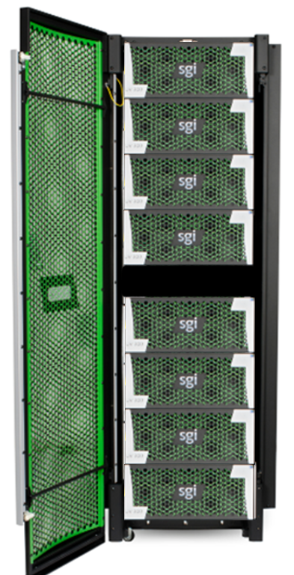
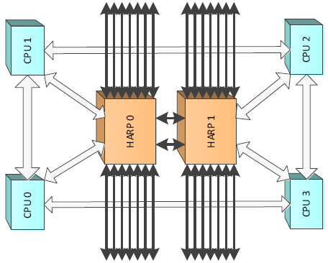
Why Multi-Rail: Big Clients
We want to support big Lustre nodes.
  SGI UV 300: 32-socket NUMA system
  SGI UV 3000: 256-socket NUMA system
  A system with multiple TB of memory needs a lot of bandwidth.
  NUMA systems benefit when memory buffers and interfaces are close in the system’s topology.

Slide 6
Why Multi-Rail: Increasing Server Bandwidth
In big clusters, bandwidth to the server nodes becomes a bottleneck.
Adding faster interfaces implies replacing much or all of the network.
  Adding faster interfaces only to the servers does not work
Adding more interfaces to the servers increases the bandwidth.
  Using those interfaces requires a redesign of the LNet networks
  Without Multi-Rail each interface connects to a separate LNet network
  Clients must be distributed across these networks
It should be simpler than this.

Slide 7
The Multi-Rail Project
  Add basic multi-rail capability
    Multiplexing across interfaces, as opposed to striping across them
    Multiple data streams are therefore needed to profit
  Extend peer discovery to simplify configuration
    Discover peer interfaces
    Discover peer multi-rail capability
  Configuration can be changed at runtime
    This includes adding or removing interfaces
    lnetctl is used for configuration
  Compatible with non-Multi-Rail nodes
  Add resiliency by using alternate paths in case of failures

Slide 8
Single Fabric With One LNet Network
This is a small Lustre cluster with a single big client node.
All nodes are connected to a single fabric (physical network). There is one LNet network connecting the nodes.
The big UV node has a single connection to this network. It has the same network bandwidth available to it as the small clients.
Client
MGS
MGT
Client
MDS
MDT
UV
OSS
OST
OSS
OST
OSS
OST

Slide 9
Single Fabric With Multiple LNet Networks
Additional interfaces have been added to the UV to increase its bandwidth.
Without Multi-Rail LNet we must configure multiple LNet networks.
Each OSS lives on a separate LNet network, within the single fabric.
Each interface on the UV connects to one of these LNet networks.
On the other client nodes, aliases are used to connect a single interface to multiple LNet networks.
Client
MGS
MGT
Client
MDS
MDT
UV
OSS
OST
OSS
OST
OSS
OST

Slide 10
Single Fabric With One Multi-Rail LNet Network
Multi-Rail LNet allows for the LNet network configuration to match the fabric.
The fabric is the same as in the previous slide.
The configuration is much simpler.
The network bandwidth to the UV node is increased to match its size.
Client
MGS
MGT
Client
MDS
MDT
UV
OSS
OST
OSS
OST
OSS
OST

Slide 11
Dual Fabric With Dual Multi-Rail LNet Networks
In this example there are two fabrics, each with an LNet network on top.
The server nodes connect to both fabrics.
The UV client connects with multiple interfaces to both fabrics.
The other client nodes connect to only one fabric.
Client
MGS
MGT
Client
MDS
MDT
UV
OSS
OST
OSS
OST
OSS
OST

Slide 12
Configuring Multi-Rail LNet

Slide 13
Use Cases
Improved performance
Improved resiliency
Better usage of large clients
  The Multi-Rail code is NUMA aware
Fine grained control of traffic
Simplify multi-network file system access

Slide 14
Two Types of Configuration Methods
Multi-Rail can be configured statically with lnetctl.
  The following must be configured statically
    Local network interfaces
      The network interfaces by which a node sends messages
    Selection rules
      The rules which determine the local/remote network interface pair used to communicate between a node and a peer
      Default is weighted round-robin
  The following may be configured statically, but can be discovered dynamically
    Peer network interfaces
      The remote network interfaces of peer nodes to which a node sends messages
Enable dynamic peer discovery to have LNet configure peers automatically

Slide 15
Static Configuration – Basic Concepts
On a node:
  Configure local network interfaces
    Example: tcp(eth0,eth1)
      <eth0 IP>@tcp, <eth1 IP>@tcp
  Configure remote network interfaces
    Specify the peer’s Network Interface IDs (NIDs)
      <peerX primary NID>, <peerX NID2>, …
  Configure selection rules

Slide 16
Dynamic Configuration – Basic Concepts
LNet can dynamically discover a peer’s NIDs.
On a node:
  Local network interfaces must be configured as before
  Selection rules must be configured as before
  Peers are discovered as messages are sent and received
    An LNet ping is used to get a list of the peer’s NIDs
    A feature bit indicates whether the peer supports Multi-Rail
    The node pushes a list of its NIDs to Multi-Rail peers

Slide 17
Selection Rules – Basic Concepts
Selection rules work by adding priorities
  Higher priorities are preferred
  The rules specify patterns
The following types of rules are supported
  Network
  Local NID
  Peer NID
  Local NID / peer NID pair
    These rules have two NID patterns, one for the local NID, one for the peer NID
    They are used to specify preferred paths

Slide 18
Example: Improved Performance
Configuring the OSS
net:
- net type: o2ib
local NI(s):
- interfaces:
0: ib0
1: ib1
Client
Client
MGS
MGT
Client
o2ib0
MDS
MDT
Client
OSS
OST
Client
Client
Client

Slide 19
Example: Improved Resiliency
Client
IB:
o2ib0
Client
MGS
MGT
Client
MDS
MDT
Client
OSS
OST
OPA:
o2ib1
Client
Client
Client

Slide 20
Example: Improved Resiliency
Configuring the Clients and OSS:
net:
- net type: o2ib
local NI(s):
- interfaces:
0: ib0
- net type: o2ib1
local NI(s):
- interfaces:
0: ib1
selection:
- type: net
net: o2ib
priority: 0 # highest priority
- type: net
net: o2ib1
priority: 1

Slide 21
Example: Multi Network Filesystem Access
Client
o2ib0
Client
MGS
MGT
Client
MDS
MDT
OSS
OST
tcp0
Client
Client
Client

Slide 22
Example: Multi Network Filesystem Access
IB Clients
net:
- net type: o2ib
local NI(s):
- interfaces:
0: ib0
peer:
- primary nid: <mgs-ib-ip>@o2ib0
peer ni:
- nid: <mgs-tcp-ip>@tcp0
selection:
- type: nid
- nid: *.*.*.*@o2ib*
- priority: 0 # highest priority
TCP Clients
net:
- net type: tcp0
local NI(s):
- interfaces:
0: eth0
peer:
- primary nid: <mgs-ib-ip>@o2ib0
peer ni:
- nid: <mgs-tcp-ip>@tcp0
selection:
- type: nid
- nid: *.*.*.*@tcp*
- priority: 0 # highest priority

Slide 23
Example: Fine Grained Traffic Control
This is a single fabric with a bottleneck.
Client1: 10.10.10.2@o2ib
Client2: 10.10.10.3@o2ib
MGS-1: 10.10.10.4@o2ib
MGS-2: 10.10.10.5@o2ib
MDS-1: 10.10.10.6@o2ib
MDS-2: 10.10.10.7@o2ib
OSS1-1: 10.10.10.8@o2ib
OSS1-2: 10.10.10.9@o2ib
OSS2-1: 10.10.10.10@o2ib
OSS2-2: 10.10.10.11@o2ib
Client1
MGS
MGT
Client2
MDS
MDT
OSS1
OST
OSS2
OST

Slide 24
Example: Fine Grained Traffic Control
This rule makes Client1 avoid the red path:
selection:
- type: peer
local: 10.10.10.2@o2ib
remote: 10.10.10.[4-10/2]@o2ib
priority: 0 # highest priority
Client1 will only use the red path if there is no other option.
Client1
MGS
MGT
Client2
MDS
MDT
OSS1
OST
OSS2
OST

Slide 25
Multi-Rail LNet Project Status

Slide 26
Project Status
Public project wiki page:
  http://wiki.lustre.org/Multi-Rail_LNet
Code development is done on the multi-rail branch of the Lustre master repo.
  Patches to enable static configuration are under review
  Unit testing and system testing underway
  Patches for selection rules are under development
  Patches for dynamic peer discovery are under development
  Estimated project completion time: end of this year
  Master landing date: TBD

